Slide 2
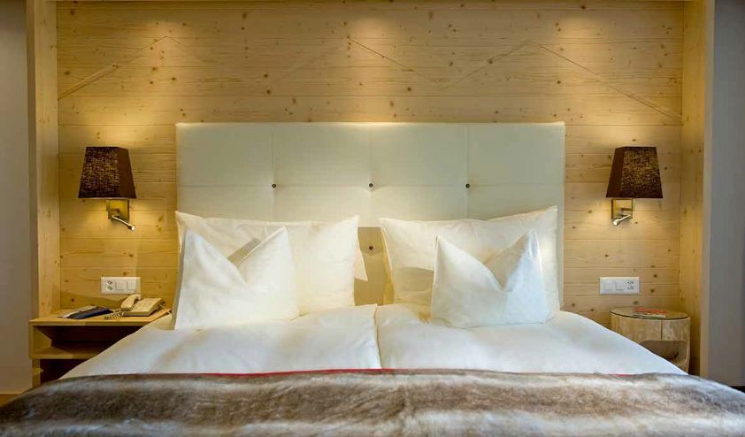

Slide 3
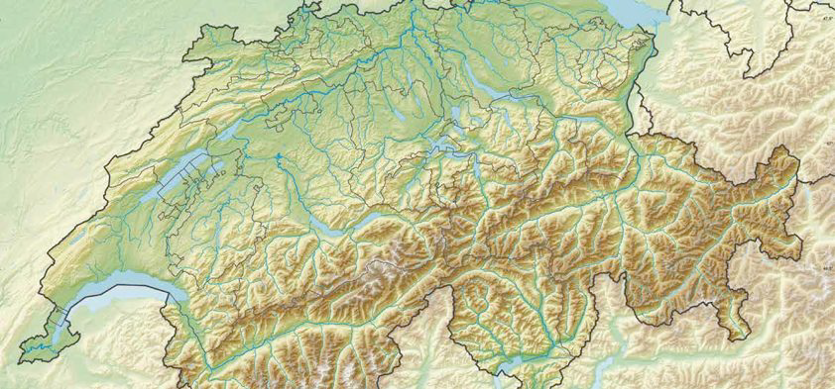
SAANENMÖSER –
Geneva: 157 km | Zürich: 201 km | Basel: 178 km | Interlaken: 60 km | Bern: 77 km
Basel
Zürich
Neuchâtel
BERN
Fribourg
Lausanne
SAANENMÖSER
Genf

Slide 4
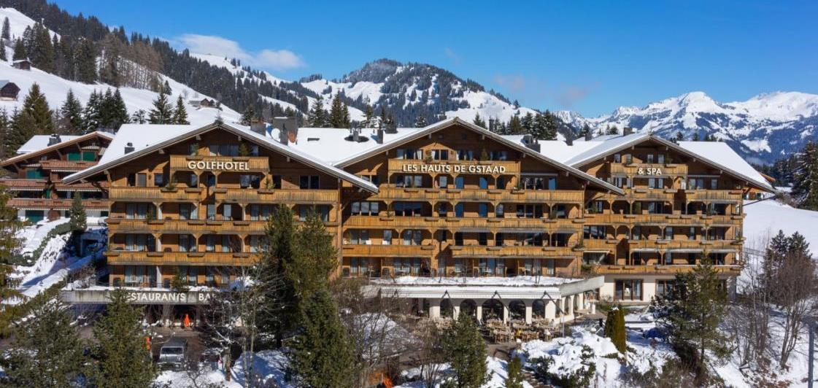

Slide 5
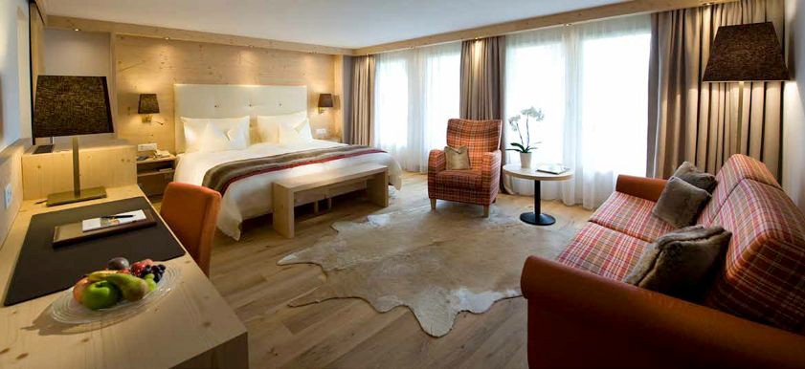
COMPLETE FACE LIFTING IN THE MAINBUILDING
Alpine chic with lots of wood, light fabrics and warm colours

Slide 6
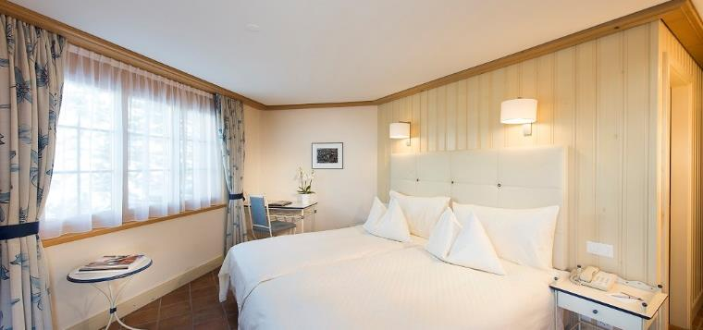
ROOMS IN CHALET GOLFINO

Slide 7
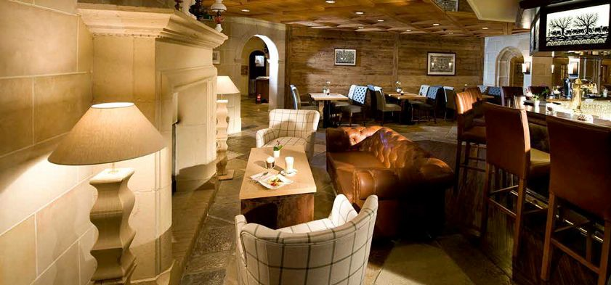
RESTAURANTS & BAR
3 restaurants with a variety of culinary highlights and one bar with fire place

Slide 8
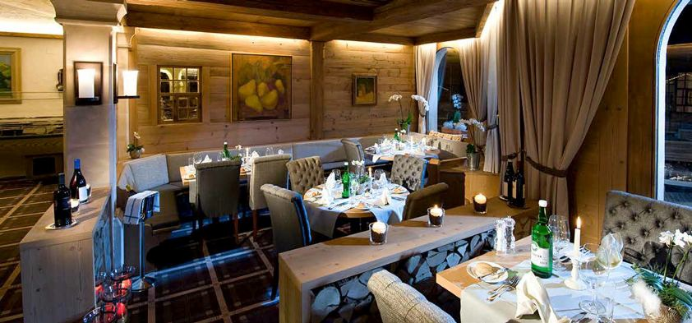
BELLE EPOQUE –
Gourmet restaurant with 14 GaultMillau Points

Slide 9
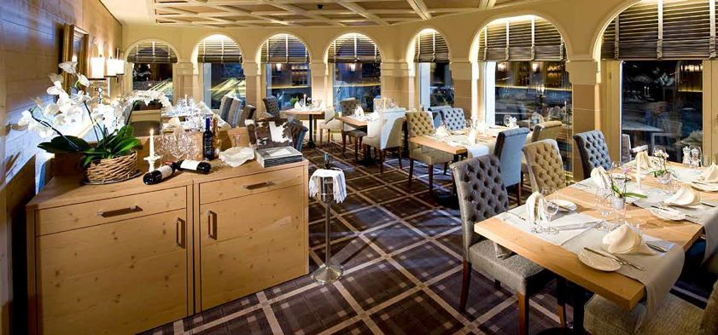
MÖSERSTUBE

Slide 10
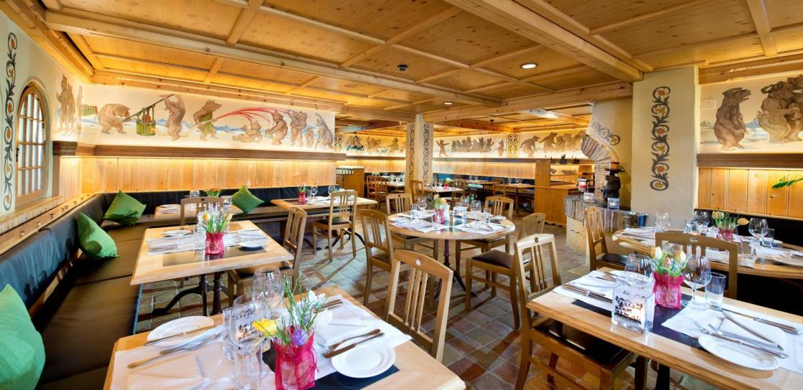
BÄRENGRABEN –
Swiss cuisine with specialities such as fondue and raclette

Slide 11
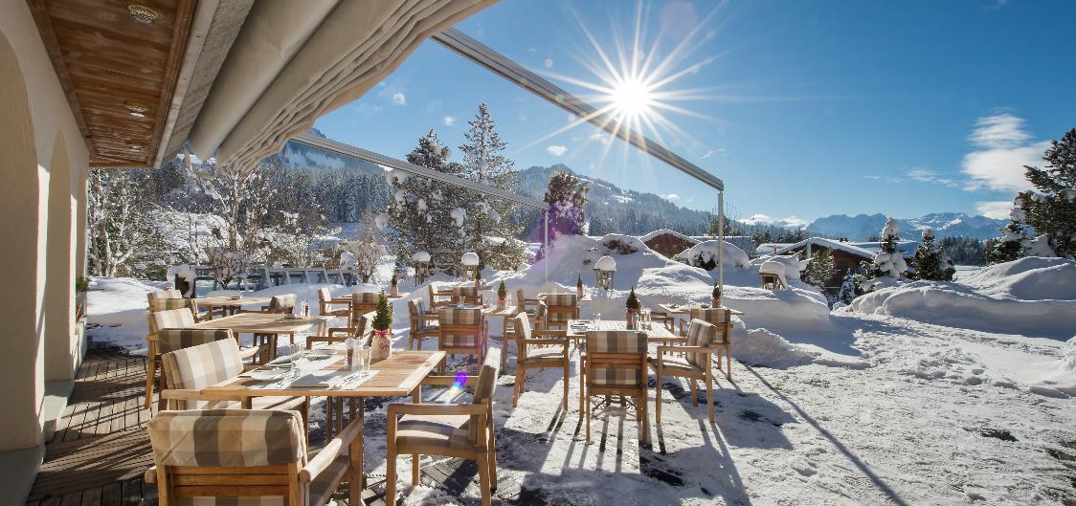
PANORAMIC TERRACE

Slide 12
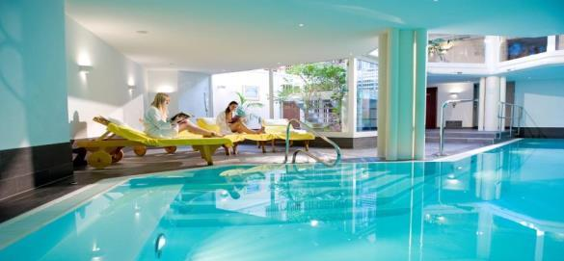
GO-WELL –
SPA & Wellness

Slide 13
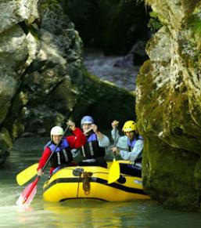
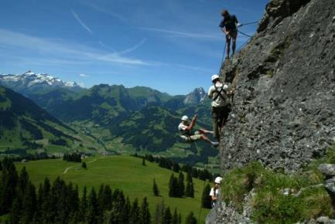
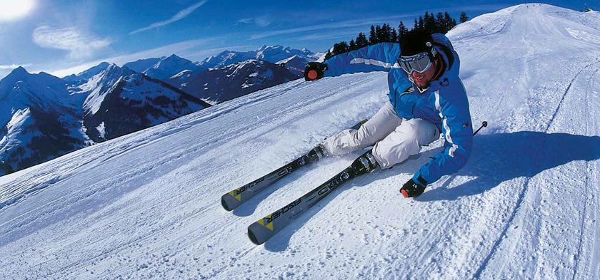
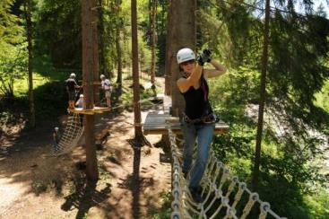
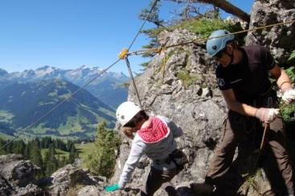
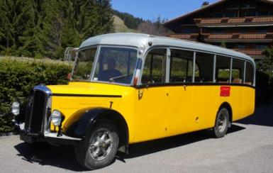
OUTDOOR ACTIVITIES

