Slide 1
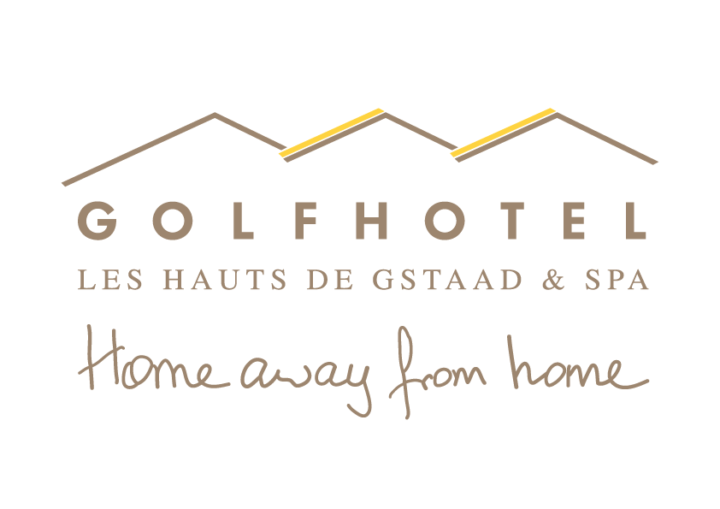

Slide 2
SAANENMÖSER –
Geneva: 157 km | Zürich: 201 km | Basel: 178 km | Interlaken: 60 km | Bern: 77 km
Basel
Zürich
Neuchâtel
BERN
Fribourg
Lausanne
SAANENMÖSER
Genf

Slide 3
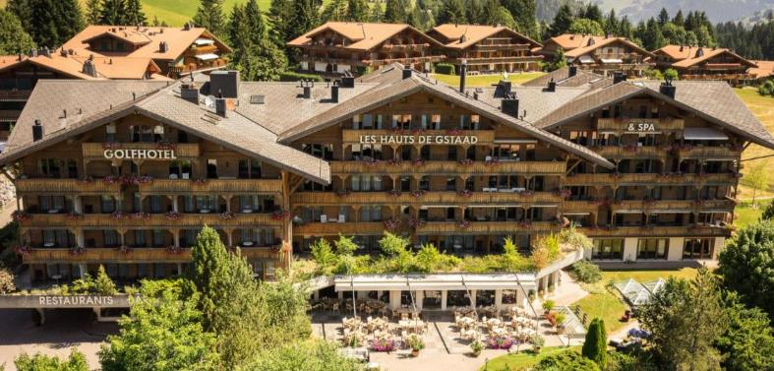
SUMMER TIME IS
when the summer breeze mingles with the mountain air and the sun sinks behind the Alpine lakes in the evenings

Slide 4
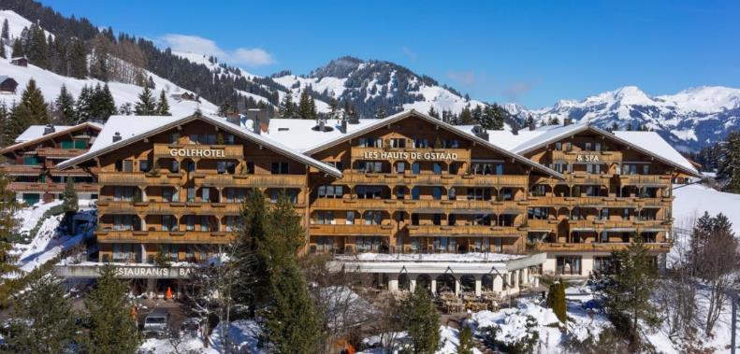
WINTER TIME IS
when the snow falls and the cozy evenings in front of the chimney begin
WINTER TIME IS
when the snow falls and the cozy evenings in front of the chimney begin

Slide 5
ROOMS
7 single rooms – 33 double rooms – 4 junior suite – 8 mini suites

Slide 6
COMPLETE FACE LIFTING IN THE MAINBUILDING
Alpine chic with lots of wood, light fabrics and warm colours

Slide 7
ROOMS IN CHALET GOLFINO

Slide 8
RESTAURANTS & BAR
3 restaurants with a variety of culinary highlights and one bar with fire place

Slide 9
BELLE EPOQUE –
Gourmet restaurant with 14 GaultMillau Points

Slide 10
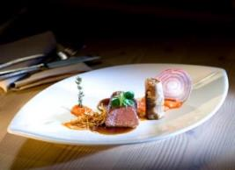
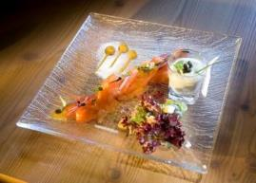
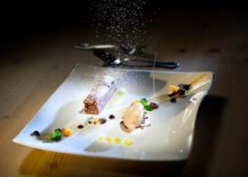
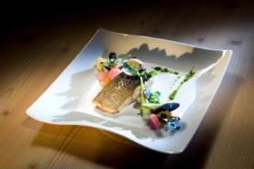
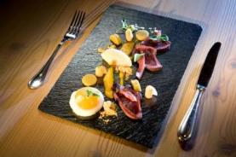
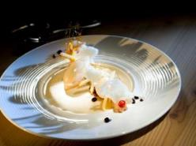
CULINARY VARIETY

Slide 11
MÖSERSTUBE

Slide 12
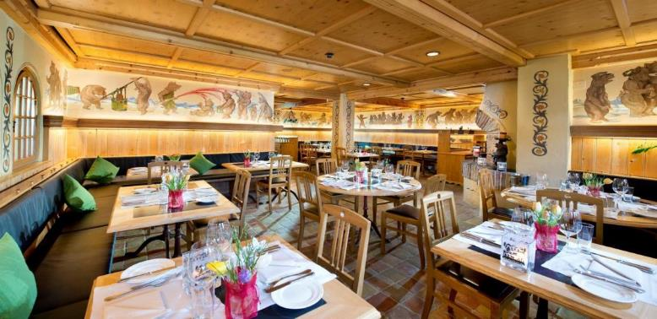
BÄRENGRABEN –
Swiss cuisine with specialities such as fondue and raclette

Slide 13
PANORAMIC TERRACE

Slide 14
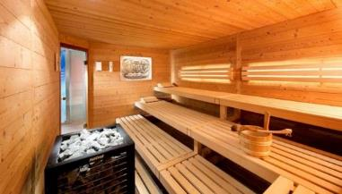
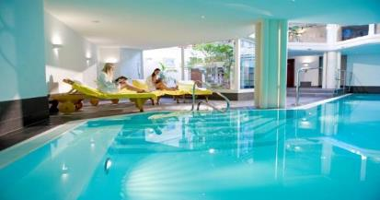
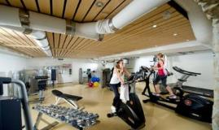
GO-WELL –
SPA & Wellness

Slide 15
OUTDOOR ACTIVITIES

Slide 16
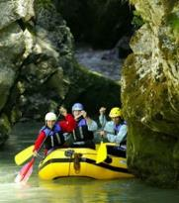
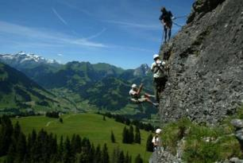
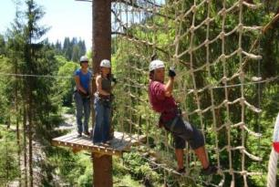
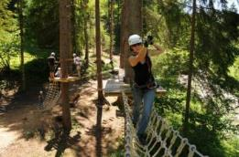
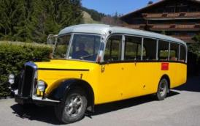
OUTDOOR ACTIVITIES

